Slide 1
Recitation 6: E20 Single-Cycle
CSUY 2214

Slide 2
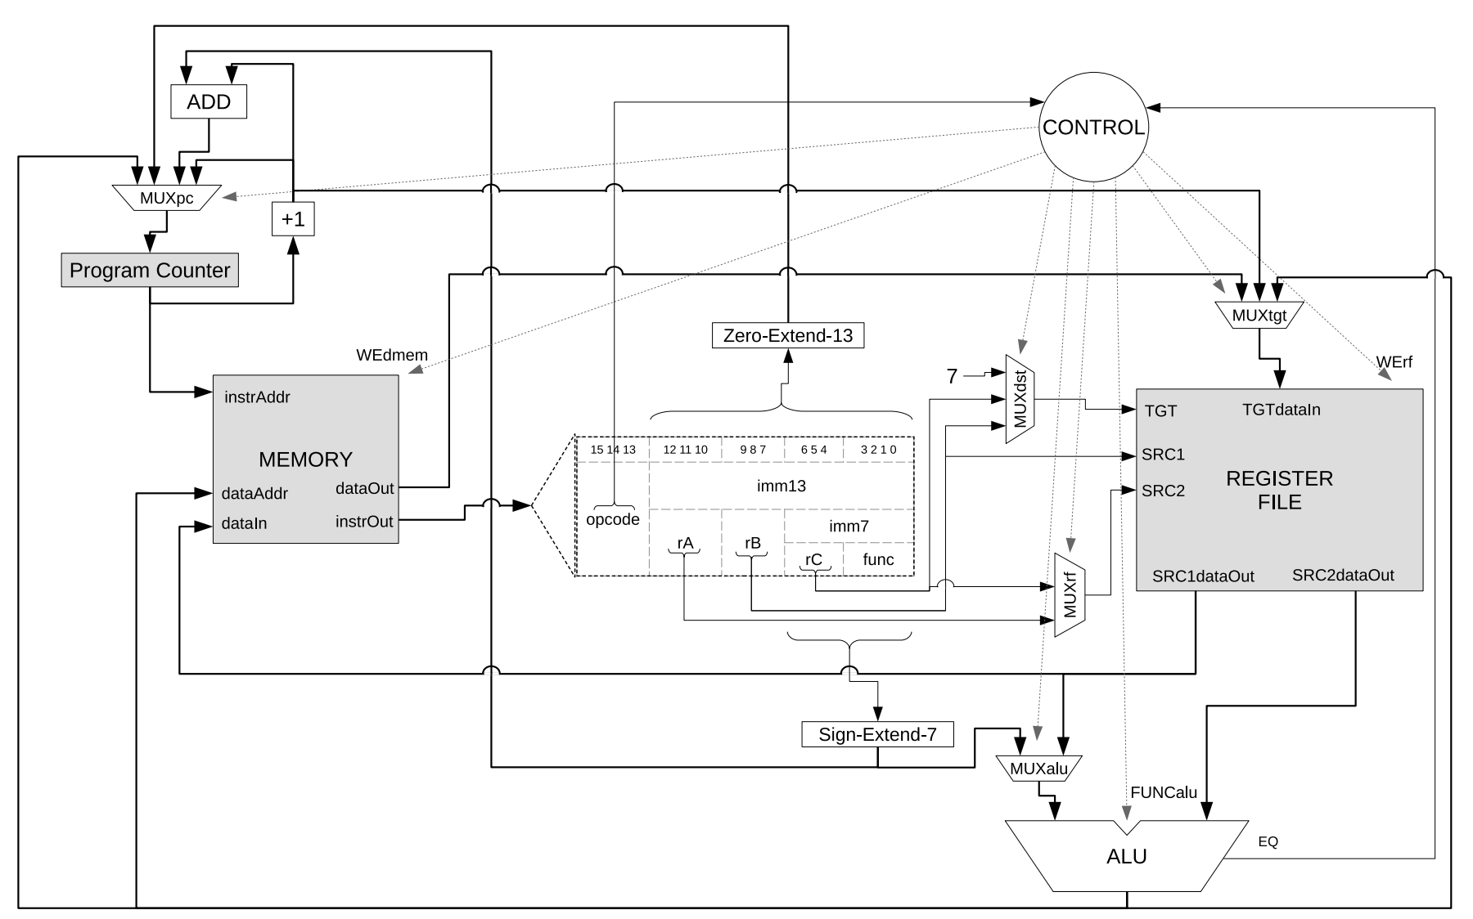

Slide 3
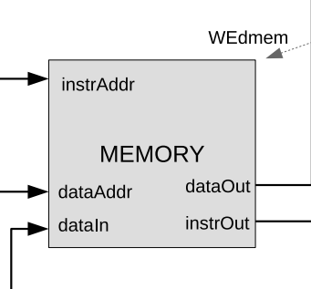
Memory
instrAddr: Address of instruction
instrOut: Instruction Value
dataAddr: Memory address
dataIn: Value input (sw)
dataOut: Value output (lw)

Slide 4
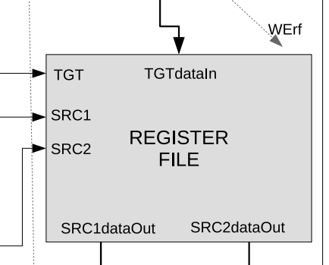
Registers
TGT: Destination register
SRC1: Source register
SRC2: Source register
SRC1dataOut: Data in SRC1 reg
SRC2dataOut: Data in SRC2 reg
TGTdataIn: Data to write to TGT register

Slide 5
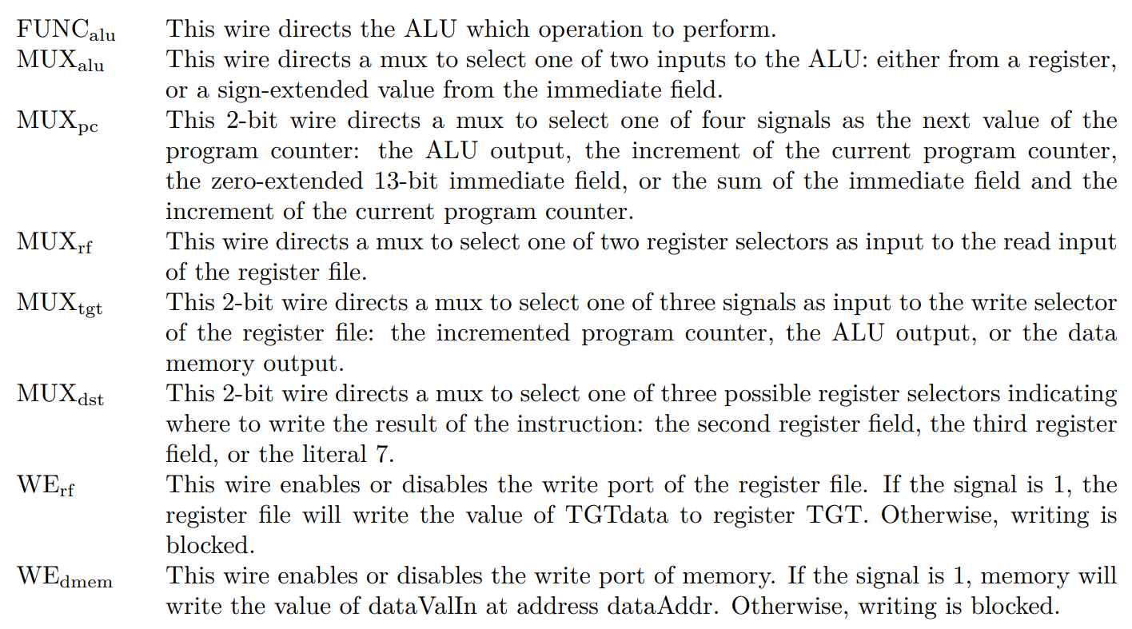
Control Signals

Slide 6
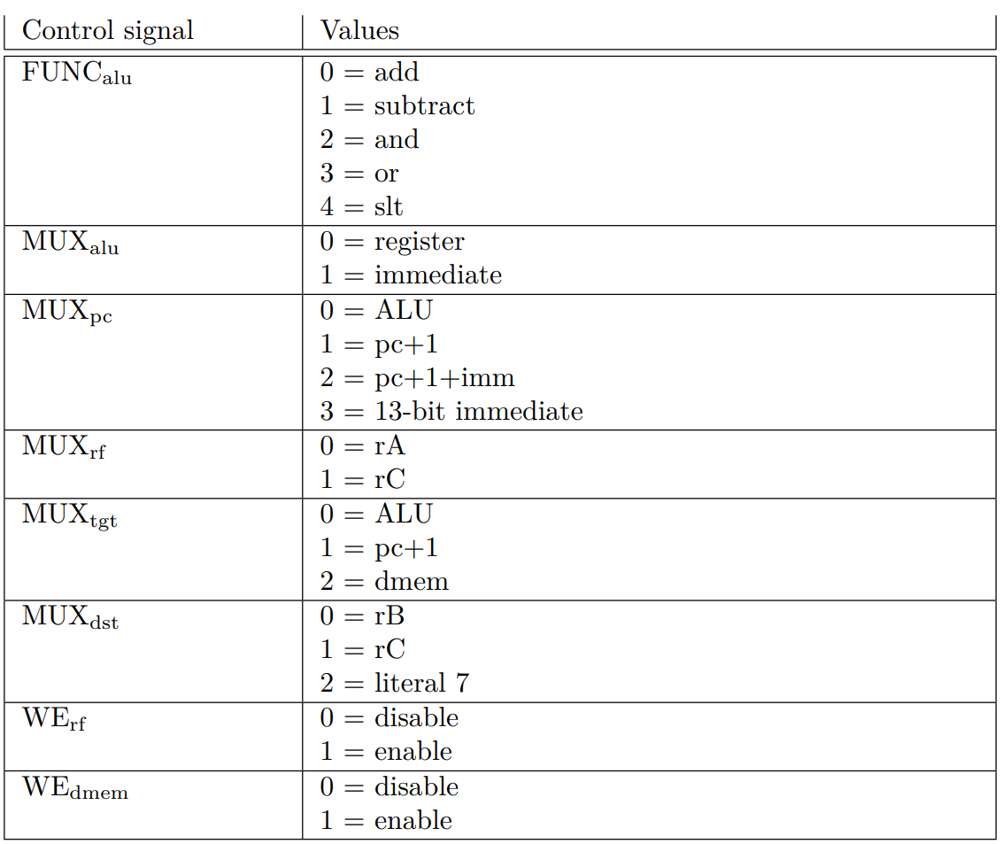
Always check first!
Should never be a “DC”

Slide 7
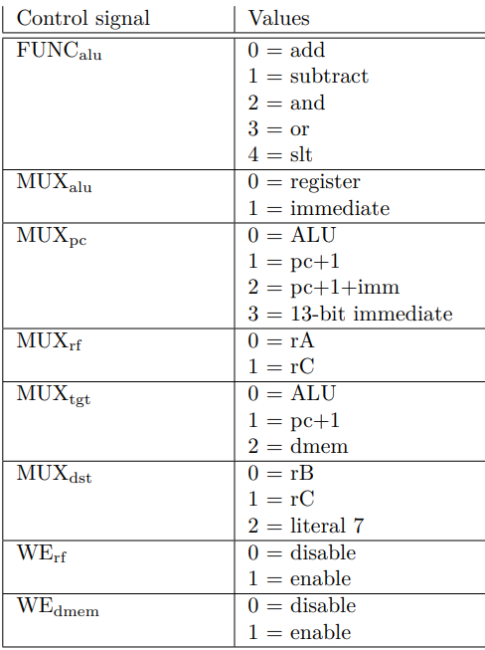
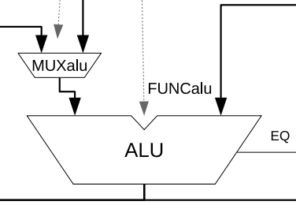
CS for Add: FUNCalu

Slide 8
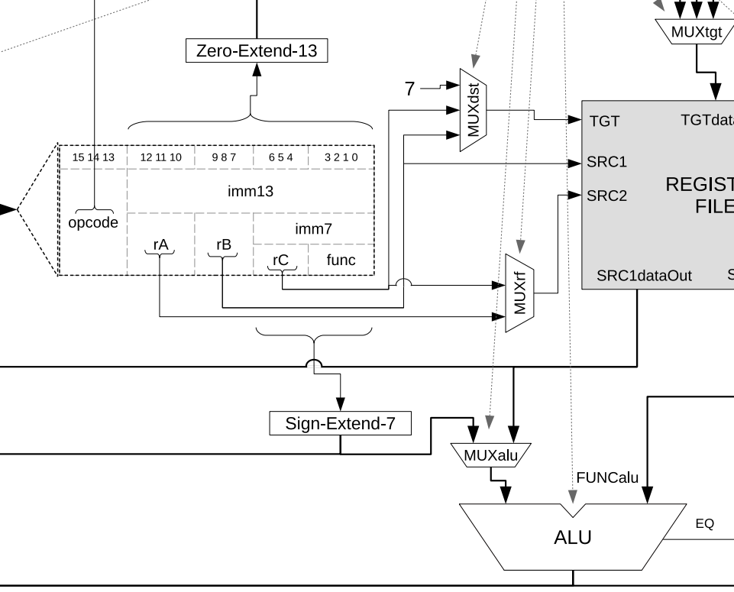
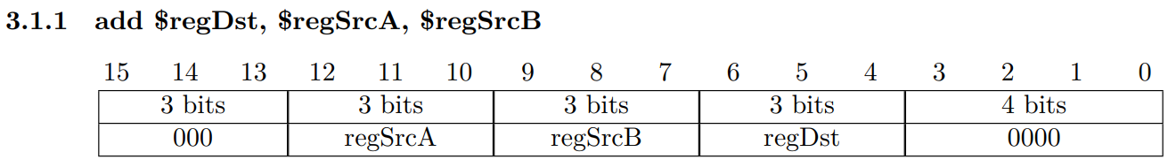
CS for Add: MUXalu

Slide 9

CS for Add: MUXpc

Slide 10

CS for Add

